Slide 1
Grand Round Fahad AlQahtani , R3
Supervised by : Dr. Abdullah Almajid
Prof. Yousri Elsayed

Slide 2
History
12 y/o boy, came with his father, c/o difficulty of hearing and speech delay.
On and off earache.
No ear discharge
No tinnitus or vertigo

Slide 3
History
Associated with:
Nasal obstruction.
Mucoid nasal discharge.
Snoring/ mouth breathing

Slide 4
Past history
Frequent chest infections ( productive cough, SOB..)
Multiple ER visits for chest infection

Slide 5
History
Perinatal history
Family history
NSVD at full term
ECHO VSD and ASD
Unremarkable
Medications:
Ventolin.

Slide 6
Examination
Examination
Ears: dull TMs, loss of light reflex.
Weber: central
Rienne is –ve
Throat : grade I tonsils, no signs of infection
Nose: full of mucoid discharge
HIT bilaterally
Mild DNS to left side
Small adenoid tissue
Chest: bilateral basal crepitations .

Slide 7
Audiology
Laboratory
Tympanogram :
Type B bilaterally
PTA : mild CHL both ears
Unremarkable

Slide 8
DDx?

Slide 9
NEXT?

Slide 10
Management
Bilateral myringotomy and VT insertion
Speech referral

Slide 11
several Months later
Patient came to clinic with bilateral mucopurulent ear discharge.
VTs in place.
With same symptoms of nasal discharge, and nasal obstruction
Frequent chest infections

Slide 12
Next ?

Slide 13
Continue
Decision was made to remove VTs

Slide 14
Several months later …
Patient came with recurrence of OME
Decreased hearing/ speech delay
Type B tympanogram
PTA: CHL
Nasal discharge/obstruction
Continuous ER visits for chest infection

Slide 15
Next ?

Slide 16
Continue
Bilateral myringotomy and VT insertion done.
But several months later …
Came with bilateral otorrhea

Slide 17
Finally
The decision was made to remove VT.
Observation
Hearing aid

Slide 18
DDx?

Slide 19
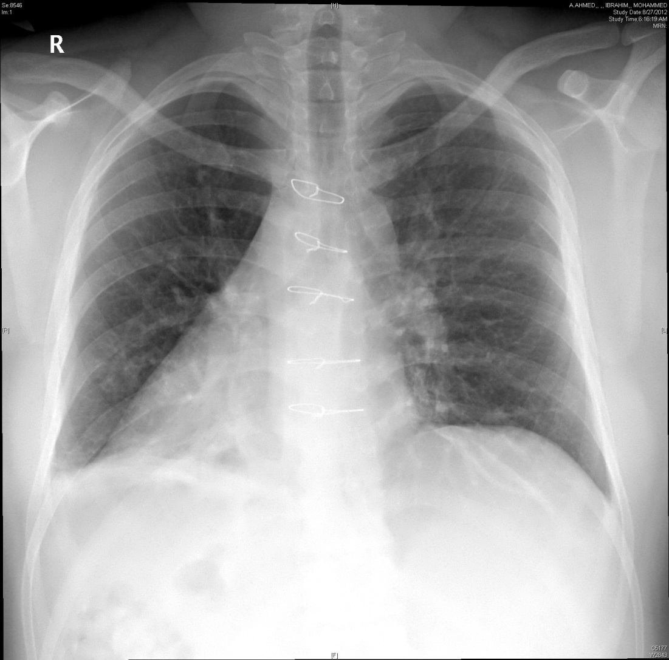
Chest X-Ray

Slide 20
How to confirm the diagnosis ?

Slide 21
Continue
Bilateral antral washout done, and biopsy taken from inferior turbinate, sent for electron microscopy.

Slide 22
Biopsy Result
Electron microscopy:
Cores of cilia and abo cilia with abnormal microtubular structures with loss of cilia in certain regions and deficiency of microtubular cisternal structures with loss of dynin arms
Findings compatible with primary ciliary dyskinesia .

Slide 23
Otological Manifestations of Primary ciliary Dyskinesia : a literature review

Slide 24
Contents
Background
Pathophysiology
Epidemiology
Presentation
Diagnosis
Otological manifestations and management

Slide 25
Primary Ciliary Dyskinesia
Autosomal recessive disease characterized by abnormal ciliary motion and impaired mucociliary clearance.
Defects in the ultrastructure and function of cilia leads to ineffective ciliary mobility and abnormal mucociliary clearance.
Leading to recurrent sinus and respiratory infections, and otitis media , male infertility.

Slide 26
PCD
Because the embryonic, nodal cilia are also defective, body asymmetry occurs randomly
Fifty percent of patients have situs inversus
When situs inversus, chronic sinusitis, and bronchiectasis occur together, an individual is said to have Kartagener's syndrome.

Slide 27
History
In 1933, Kartagner syndrome was first described.
Later, Afzelius noted that these patient have defects in the ultrastructure of cilia, and introduced the term immotile cilia.
Later studies showed that disorganized motion, rather than immotile cilia, resulted in the ineffective ciliary beat, hence the term ciliary dyskinesia

Slide 28
History
Because transient ciliary dyskinesia may occur following epithelial injury from viral respiratory tract infections or exposure to pollutants, the term primary ciliary dyskinesia (PCD) is used to describe the genetic defect and to differentiate it from acquired defects.

Slide 29
Ciliary structure and function
Respiratory epithelium (pseudostratified ciliated columnar ), lines the large airways and contiguous structures, including the paranasal sinuses, middle ears, Eustachian tube and nose.
Each matured ciliated cell has up to 200 cilia
Ependymal lining of the brain and fallopian tubes.
the spermatozoal flagella (tail of spermatozoa

Slide 30
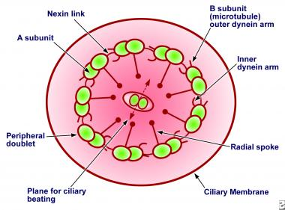
Ciliary structure and function

Slide 31
Ciliary structure and function
Ciliary movement involves 2 phases: an effective stroke phase that sweeps forward and a recovery phase during which the cilia bend backward into the starting position for the stroke phase.
Using ATP as an energy source.. motility is accomplished by stimulation of the dyein arms, attached to the doublet microtubules
This movement work to propel the secretions forward.

Slide 32
Ciliary structure and function
Mucosal blanket covering cilia
Goblet cell-produced glycoproteins give the gel layer of nasal mucus its viscosity and elasticity.
Sol layer , less viscos, allowing ciliary movement, propelling the overlying gel an particles.

Slide 33
Ciliary structure and function
In all the sinuses, mucus moves toward the natural ostia.
Once mucus has drained from the sinuses into the nasal cavity, mucus flow is toward the nasopharynx.
The cilia in the trachea and bronchi beat upwards, towards the throat
The mucous blanket is cleared toward the nasopharynx every 10 to 15 minutes, and replaced by fresh mucus.
Normal cilia beat frequency is 9 to 15 Hz
results in a normal mucus velocity between 3 and 25 mm/min

Slide 34
Pathophysiology
autosomal recessive disease.
Defects in the ciliary component causing abnormal ciliary movement.
The two most common genes mutated in PCD include DNAI1 (outer dyein arm intermediate chain) and DNAH5 (outer dyein arm heavy chain), both of which have been implicated in 30% to 38% of PCD patients.

Slide 35
Pathophysiology
Other mutations include:
Inner dynein arms (DNALI1)
Radial spoke head gene mutations (eg, RSPH4A, RSPH9)
Lack of Central core structures
Normal cilia or subtle ultrastructural abnormalities - DNAH11, HYD1N (functional abnormality)

Slide 36
Pathophysiology
Other defects, such as ciliary aplasia, ciliary disorientation, malaligned central pair of microtubules in adjacent cilia, and basal body abnormalities may occur after viral infections, making it unclear if they are primary or secondary defects.

Slide 37
Epidemiology
1 per 26,000-40,000 live births
likely to be an underestimate because of misdiagnosis .
Probability of having subsequent children with PCD is 1:4.
No sex or race predilection.

Slide 38
Presentation
It commonly presents with neonatal respiratory distress, recurrent childhood pulmonary infections, chronic otitis media, and CRS.
Most patients with PCD present in childhood (median age of diagnosis 5 to 5.5 years), but some present in adulthood (median age of diagnosis 22 years)

Slide 39
Presentation
Rhinosinusitis is a cardinal feature of PCD, occurring in almost 100% of affected individuals.
Nasal polyposis is frequently present.
Chronic sinusitis typically involves the maxillary and ethmoidal sinuses, as the frontal and sphenoid often fail to develop.

Slide 40
Pulmonary
Newborns with PCD often suffer from mild respiratory distress, (tachypnea or mild hypoxemia), and may require supplemental oxygen for a few hours to days after birth.
Patients with bronchiectasis generally manifest auscultatory crackles and may have wheezes that mimic asthma, particularly in children.

Slide 41
Situs inversus and Kartagener syndrome
Complete reversal of the circulatory system and the viscera known , including dextrocardia
Situs inversus has no serious adverse health consequences per se, and the condition often goes undetected until a chest radiograph is obtained.
Very useful sign if PCD diagnosis is considered.
50 percent of patients with PCD.

Slide 42
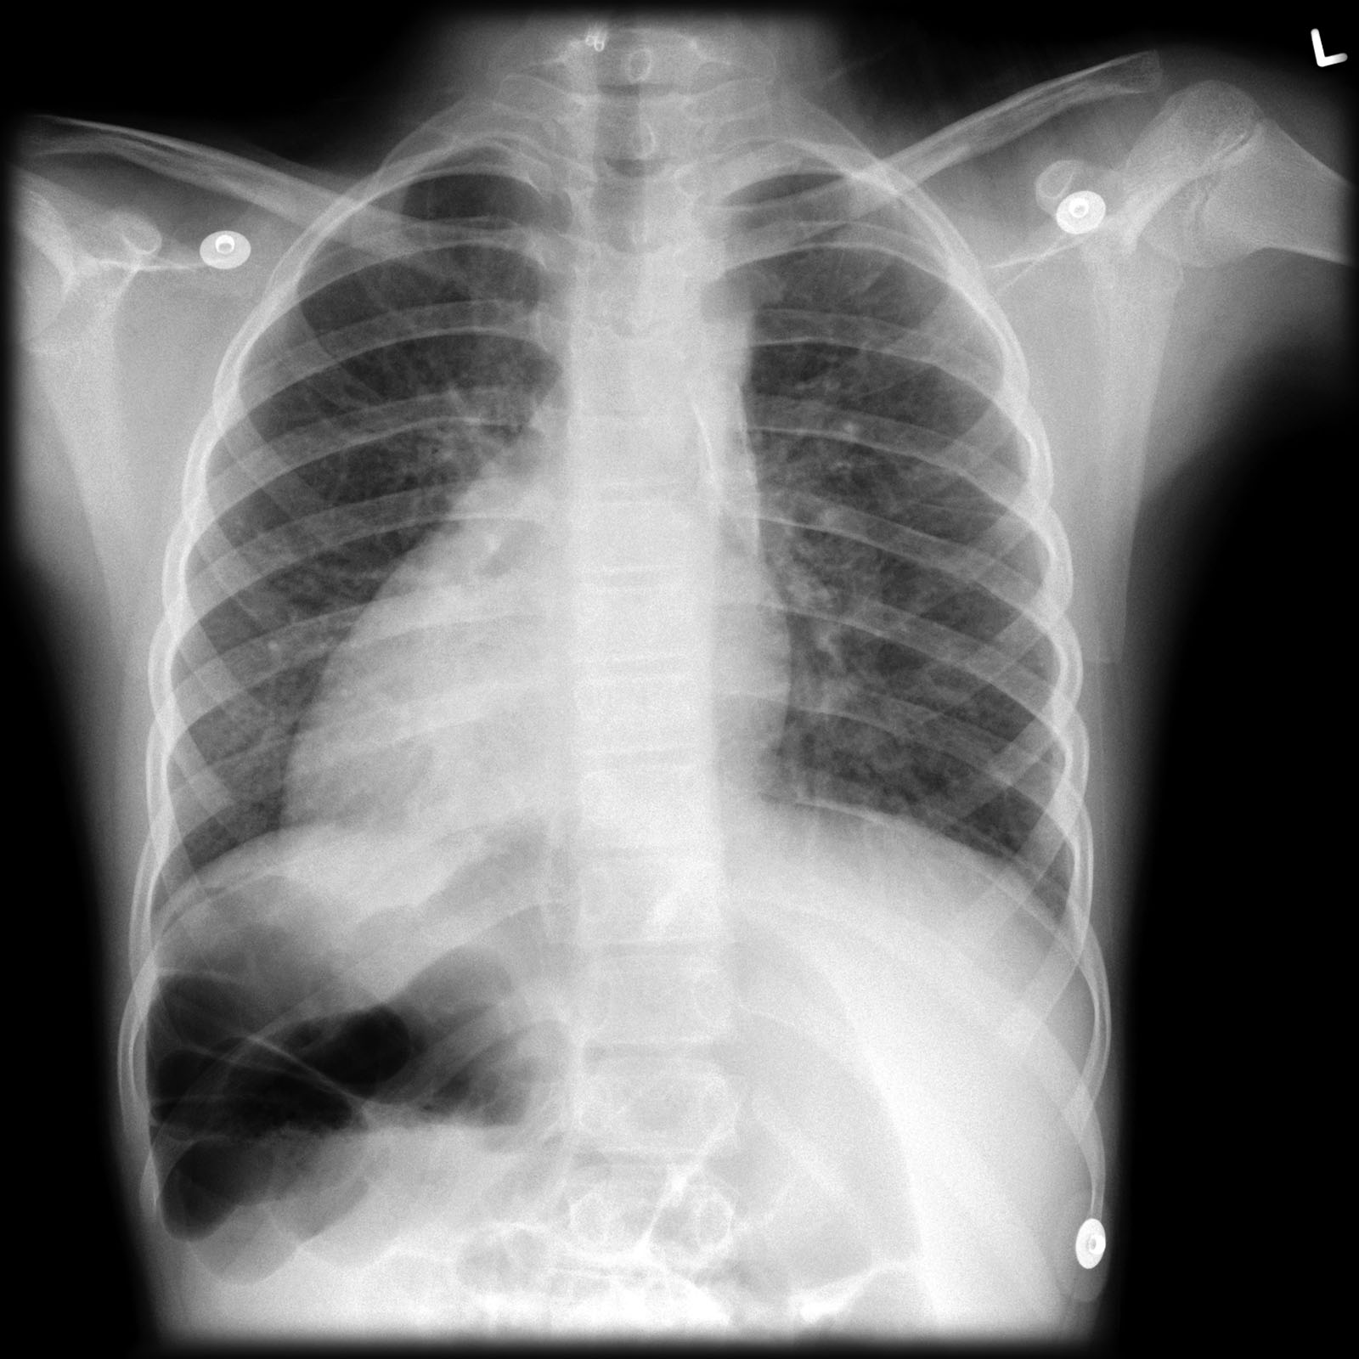
Situs Inversus

Slide 43
CNS
Hydrocephalus has been described from several persons with primary ciliary dyskinesia and two siblings with ciliary aplasia . Impaired function of ependymal cilia may be at least partially responsible.

Slide 44
Fertility
Most men with PCD have living but immotile spermatozoa and are infertile.
Women have decreased fertility, with fewer than 50% successfully completing pregnancy.
Impaired ciliary function in the fallopian tubules can delay ovum transit leading to reduced fertility or ectopic pregnancy.

Slide 45
Cardiac
Congenital cardiac anomalies are 200-fold higher in PCD than the general population.

Slide 46
Investigations
Saccharin Test:
The traditional screening modality for PCD. It measures mucociliary clearance by placing a saccharin microtablet onto the anterior head of the inferior turbinate and quantifying the time it takes for the patient to taste the sugar. values shorter than 20 minutes are considered in the normal range. The saccharin test is unreliable in children and therefore it is not commonly used during the diagnosis of PCD.

Slide 47
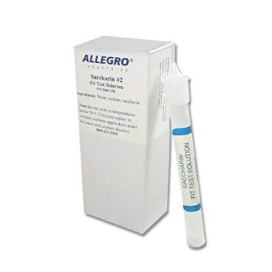
Saccharin test

Slide 48
Nasal Nitric Oxide
Has become the preferred screening modality for PCD. A nasal catheter is placed through a foam sleeve.. which is used to seal the nostril from the atmosphere and measure the concentration of nitric oxide. During nNO measurements, the patient performs maneuvers designed to close the soft palate.. which minimizes the contamination of nasal gases by pulmonary gases.

Slide 49
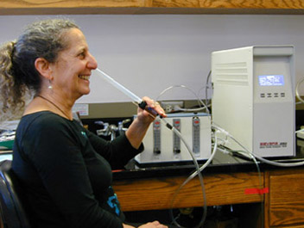
nNO
Due to technical considerations surrounding the palate closure maneuvers, the youngest age for nNO measurements is 5 years old.

Slide 50
nNO
Several studies have demonstrated that patients with PCD will have low levels of nNO . False-positive low nNO can occur with CF, panbronchiolitis, and nasal polyposis.
Therefore, screening results with a low nNO level, require other confirmatory tests, such as ciliary ultrastructure analysis or genetic analysis to confirm PCD.

Slide 51
Ciliary Ultrastructure Analysis
Using transmission electron microscopy. Fresh ciliated mucosal biopsies are performed and placed in glutaraldehyde. The preferred mucosal biopsy technique is a brushing from the bronchi and pharynx; however, other options include endoscopic bronchial tissue biopsy or inferior turbinate biopsy. most common abnormalities include: (a) absence or shortening of dyein arms, (b) absence of radial spokes, and (c) loss of the central pair of microtubules with transposition of a peripheral doublet into the center

Slide 52
Ciliary Ultrastructure Analysis

Slide 53
Ciliary Motility Analysis
Fresh respiratory mucosal biopsies are placed in isotonic saline and rapidly transferred to a lab for high-speed video microscopy.
Cilia are then evaluated for the following beat characteristics: (a) coordination. (b) frequency, and (c) pattern.

Slide 54
Ciliary Motility Analysis
Certain beat patterns have been correlated with specific ultrastructural defects:
Immotile or flickering cilia correlate with outer dyein arm defects
Low-amplitude stiff beats correlates with either an isolated inner dyein arm defects or radial spoke defect
A whip-like beat correlates with central microtubule defects,

Slide 55
Genetic analysis
Can be challenging due to genetic heterogeneity and the extensive size of PCD causing genes.
The two most common genes mutated in PCD include DNAI1 and DNAH5 both of which have been implicated in 30% to 38% of PCD patients

Slide 56
Otological Manifestations

Slide 57
Introduction
Otologic features in PCD patients are generally explained by the defective ciliary function in the Eustachian tube and middle ear cleft, impairing mucociliary clearance.

Slide 58
OME
Middle ear fluid without symptoms or signs of acute inflammation.
Most common cause of acquired conductive hearing loss in childhood.
10–30% prevalence in the 1–3 year age group.

Slide 59
OME
Treatment aims to:
Prevent long term sequelae of hearing loss (impaired speech and language).
prevent potential sequelae of OME such as tympanic membrane atelectasis and retraction pockets, ossicular chain erosion or necrosis and cholesteatoma.

Slide 60
OME
In patients with PCD , there is a dilemma .
whether VTs are of benefit in these children or whether, by placement of VT, a dry ear with OME and hearing loss is converted to a chronically discharging ear with OME and hearing loss.

Slide 61
Literature review
8 papers identified .
2 studies assessed the natural history of 87 patients with OME and PCD.
6 papers reviewed the treatment of 81 patients with PCD and OME.
Most of the papers are published 10 years ago or more.

Slide 62
Literature review
These 8 papers comprise:
5 retrospective observational studies/case series
1 cross-sectional study
1 case report
1 letter in reply discussing 2 patients

Slide 63
Literature review
4 papers recommend against VT
2 papers in favor of VT
2 papers made no conclusion regarding treatment of OME in PCD PTs

Slide 64
Majithia et al.
Study design | Aim of study | N and age of pts | Outcomes assessed | Findings
Cross-sectional retrospective observational | Document severity of hearing loss and natural progression of OME in PCD (pts with VTs or perforation excluded) | n = 134 ears in 71 Children ; 3–15 yrs | Otoscopy, PTA and tympanometry | Mean PTA thresholds and tympanograms approached normal (25dB at 0.5–4kHz) over a fluctuant course in majority by age 12 yrs
Conclusion :Improvement in outcomes with age
justifies conservative management

Slide 65
van der Baan et al.
Study design | Aim of study | N and age of pts | Outcomes assessed | Findings
Cross-sectional observational | Assess importance of cilial activity and Eustachian tube pump in middle ear status by studying PCD patients | n = 16; 1–59 yrs | Questionnaire, otomicroscopy, PTA (AB gap), tympanometry | Improvement in all measures with age. OME most common from 1 to 30 yrs
Conclusion: MCC only important from 0 to 30 yrs of age,,
Deficient mucociliary system can be compensated for with age

Slide 66
El Sayed et al.
Study design | Aim of study | N and age of pts | Outcomes assessed | Findings
Cross-sectional observational | Discuss features and principles of management of otologic disease in PCD | n = 16; 2–46yrs (mean 17.5yrs) | PTA, otomicroscopy | All pts<12 yrs (n = 11) had OME and hearing loss. All pts>12 yrs (n = 5) no OME 4/5>12 yrs had tympanosclerosis and normal PTA 1 bilateral cholesteatoma (age 24 yrs) and hearing loss, 1 bilateral keratosis obturans (age 53 yrs) but normal PTA
Conclusion: Children with PCD suffer bilateral
unrelenting OME and hearing loss
and benefit from VT insertion and
adenoidectomy

Slide 67
Ernstson et al.
Study design | Aim of study | N and age of pts | Outcomes assessed | Findings
Case series | Discuss otologic aspects of PCD and its relevance to the aetiology of OME | n = 6; 6–30 yrs | Otomicroscopy, PTA | 4/4 adults had tympanosclerosis and/or atelectasis 2/4 adults had OME and fluctuant PTA 2/2 children with OME prior to VT insertion, normal PTA and no OME after VT
Conclusion: Children have persistent OME. Adults have no OME but sequelae such as tympanosclerosis. Conservative treatment recommended

Slide 68
Turner et al
Study design | Aim of study | N and age of pts | Outcomes assessed | Findings
Cross-sectional observational | Analyse clinical features suggestive of PCD | n = 21; 2–24 yrs Mean: 13 yrs | Otomicroscopy, PTA | All pts had OME and fluctuant symptoms, 13/21 had hearing loss (age not specified)
OME is an omnipresent clinical feature
in adults and children with PCD

Slide 69
Otorrhea

Slide 70
Mygind and Pedersen
Study design | Aim of study | N =n/ age | Findings post VT insrtion | conclusion
Case series | Review otorhinolaryngological symptoms, signs and investigations in PCD | n = 27 4–56 yrs (mean 24 yrs) | 17 otorrhoea 3/17 otorrhoea persisted for ‘‘many months’’ 10/17 ‘‘continuous’’ otorrhoea | Conservative management for OME recommended as surgical management not effective. Hearing thresholds improve to normal by age 9 yrs regardless of treatment

Slide 71
Hadfield et al.
Study design | Aim of study | N =n/ age | Findings post VT insrtion | conclusion
Case series | Review authors’ institution’s treatment of OME in PCD and compare to current literature | n = 29 1month–9 yrs (detailed age data not presented) |  | PTA<25dB: no treatment PTA 25–40 dB: HA PTA>40 dB for >3 months: unilateral VT

Slide 72
Biggart et al.
Study design | Aim of study | N =n/ age | Findings post VT insrtion | conclusion
Case report | Describe 2 children with PCD and abnormal ciliary orientation | n = 2 Age <6 yrs (exact age not specified) 1 treated with VT | Continuous otorrhoea for ‘‘many months’’ | No conclusion regarding otorrhea and VT insertion

Slide 73
El-Sayed et al.
Study design | Aim of study | N =n/ age | Findings post VT insrtion | conclusion
Case series | Discuss features and principles of management of otologic disease in PCD | n = 16 | No chronic otorrhoea in 11/11 children <12 yrs of age post-VT insertion and adenoidectomy at 2.2 yrs follow-up | VT insertion restores hearing and may prevent complications

Slide 74
Bluestone et al.
Study design | Aim of study | N =n/ age | Findings post VT insrtion | conclusion
Case report | Discuss the importance of Eustachian tube dysfunction in OME in PCD | N=2 12 and 13 yrs | No otorrheoa two weeks post-VT insertion | No conclusion regarding otorrhoea and VT insertion

Slide 75
Otorrhea
Despite the paucity of accurate data, cumulative results from the 5 papers suggests that 33% of PCD patients experienced chronic otorrhoea post-VT insertion.
Post-VT otorrhoea in the general population is reported to be about 3.8- 10%.

Slide 76
Otorrhea
The available data suggests higher incidence of otorrhoea post-VT insertion in PCD compared with the general population.
otorrhoea lasting more than 3 days has been found to be a predictor of poorer quality of life (R.M. Rosenfeld et al)

Slide 77
Hearing Post VT

Slide 78
Hadfield et al.
Study design | Aim of study | N =n/ age | Outcome measures | Findings
Retrospective case review | Report authors’ experience treating OME in PCD | n = 29 1month–9yrs (detailed age data not presented) | PTA or localised distraction tests, otoscopy, tympanometry in the following groups: Conservative VT HA VT and HA | PTA improved to normal by age 9 yrs regardless of treatment. VT insertion results in minimal/no change in hearing
Conclusion: Conservative treatment recommended

Slide 79
El-Sayed et al.
Study design | Aim of study | N =n/ age | Outcome measures | Findings
Case series | Discuss features and principles of management of otologic disease in PCD | n = 11 2–46 yrs (mean 17.5yrs) all treated with VT + adenoidectomy | PTA, otomicroscopy | Normal PTA post-VT in 7/11 suitable for PTA at mean f-up 2.3 yrs
Conclusion: Hearing loss improves after VT
insertion and adenoidectomy

Slide 80
Bluestone et al.
Study design | Aim of study | N =n/ age | Outcome measures | Findings
Case report | Discuss importance of Eustachian tube dysfunction in OME in PCD | n=2 12&13 yrs VT in both | PTA, otomicroscopy | Normal PTA in both children two weeks post-VT insertion
Conslusion :VT change middle ear-nasopharynx pressure relationship allowing drainage of secretions via
Eustachian tube

Slide 81
Hearing
3 studies assessed hearing post-VT insertion in 21 children with PCD.
100% had normal hearing postoperatively.

Slide 82
TM Structural Changes
VTs associated with higher incidence of TMs changes (tympanosclerosis, atrophy, pars tensa atelectasis and attic retraction) in many studies.
tympanosclerosis in 9% and 28% of PCD patients post-VT insertion. Compared with means of 32% and 36.6% in general population (meta analysis)

Slide 83
TM Structural Changes
atelectasis in PCD , incidence varied from 3% to 50%, compared with 10% of general population.
TM perforation incidence is 9-27% , compared with 4.8 % of general popultion (D.J. Kay, M. Nelson)
Post-VT TM abnormalities have not been found to contribute significantly to hearing loss.

Slide 84
Conclusion
PCD patients have severe, early-onset, otologic symptoms that persist throughout childhood.
VT insertion in PCD children improves hearing during this critical period of language development.
Their might be a higher incidence of otorrhea in PCD patients post VT, but this is not constant.
Hearing aid should always be considered.

Slide 85
Thank You

Slide 86
Quiz !

Slide 87
Question 1
Regarding ciliary structure and function, all are true except:
Have a 9+2 microtubular structure
Beat at a frequency of approximately 120 HZ
Are dysfunctional at Kartagener syndrome
May be functionally assessed by saccharin test
May be functionally assessed by nasal brush biopsy

Slide 88
Question 2
Kartagener syndrome is caused by defect in:
Dystrophin
Ankyrin
Dyenin
Kinesin

Slide 89
Question 3
Regarding kartagener syndrome, all are true except:
Present in 50% of PCD patients
Maybe associated with hydrocephalus
Saccharin test is normal if it is less than 20 minutes
Most common ciliary defect is absent radial spokes

